Slide 1

Programming Foundations
Level 1

Slide 2

Programming Foundations
Level 1
Hexadecimal Part 2
Binary (Fast Direct Conversions
direct nibble mapping)
2

Slide 3
Programming Foundations
Level 1
Convert Hexa to Binary?
2

Slide 4
Hexadecimal ↔ Binary (Fast Direct Conversions - direct nibble mapping)
Hex is the most readable way to look at binary. In this lesson you’ll learn two ways to convert between hexadecimal and binary — including the direct nibble mapping that turns every hex digit into exactly 4 bits (and back) with no arithmetic.

Slide 5
How to Convert Hexa to Binary?
Way 1 (Two-step):
Two steps:
1. Convert hexa to decimal.
2. Convert decimal to binary.
That’s it.

Slide 6
How to Convert Hexa to Binary?
Way 2 (Direct):
Map each hex digit → 4-bit nibble. (Fastest; what pros use).
Example mapping:
A→1010, B→1011, C→1100, D→1101, E→1110, F→1111.

Slide 7
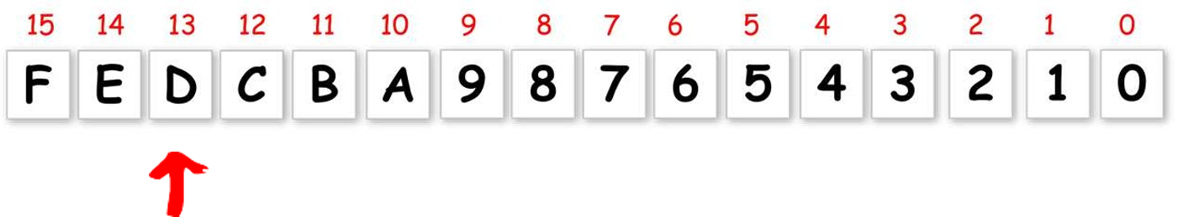
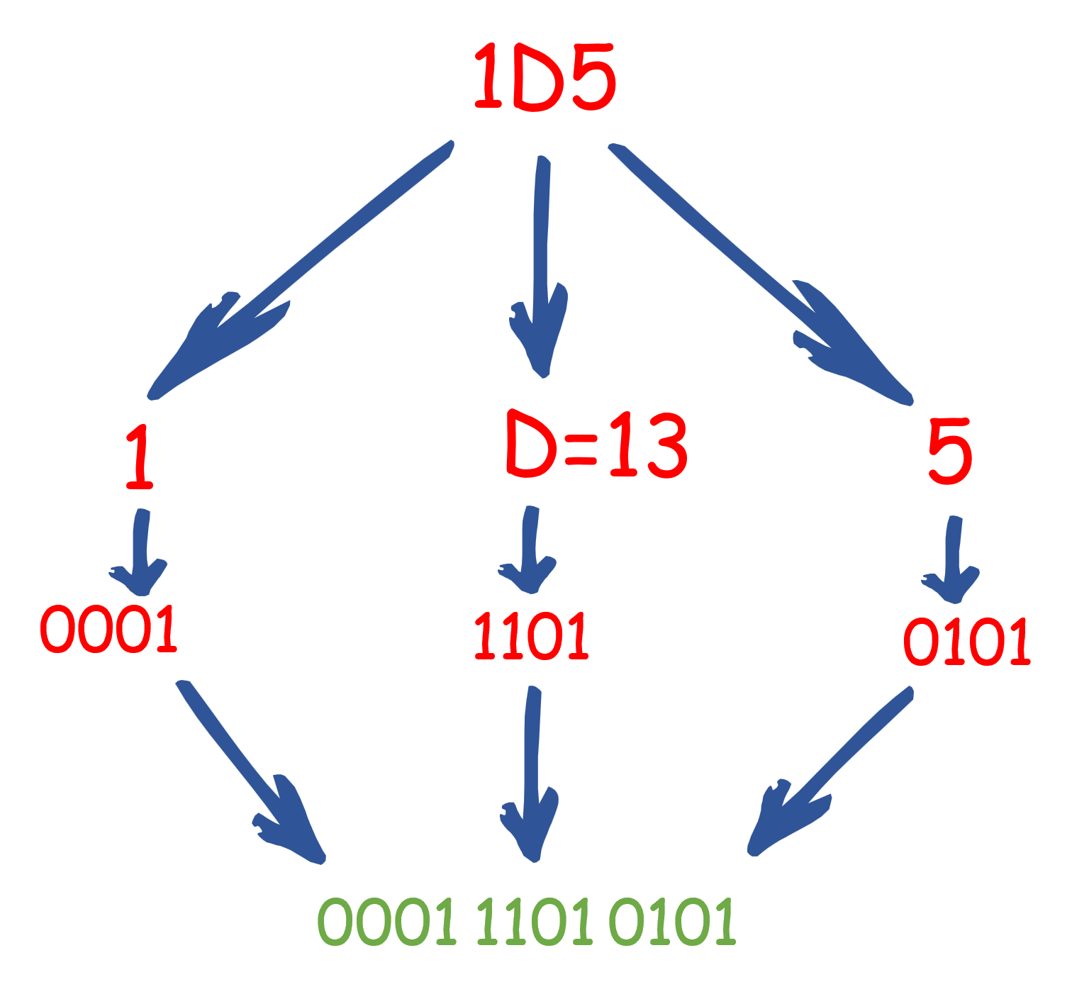
Direct Conversion:
Convert 1D5 to Binary

Slide 8
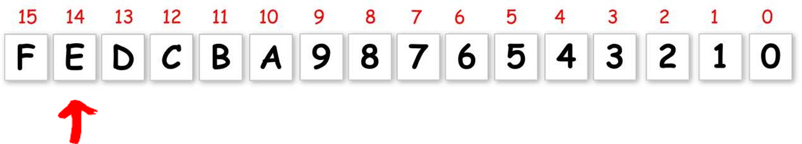
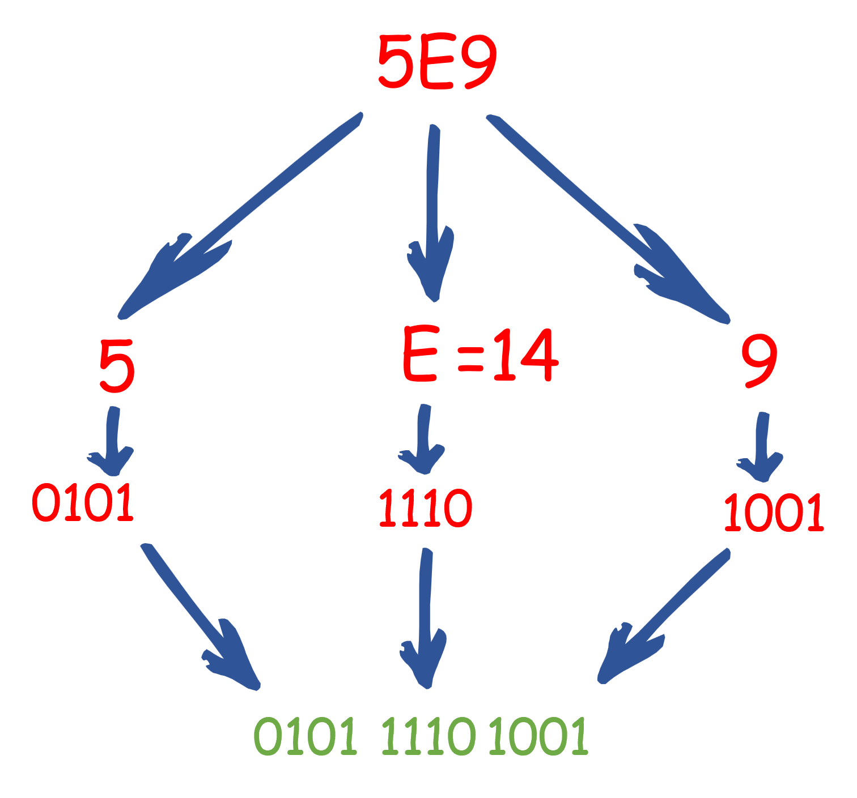
Direct Conversion:
Convert 5E9 to Binary

Slide 9
Direct Conversion:
Convert 5E9 to Binary

Slide 10
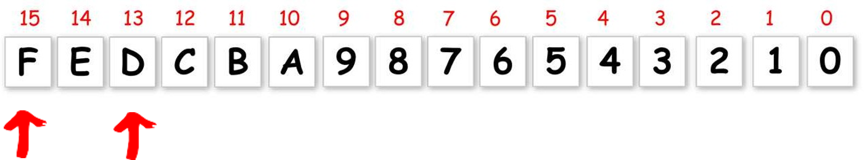
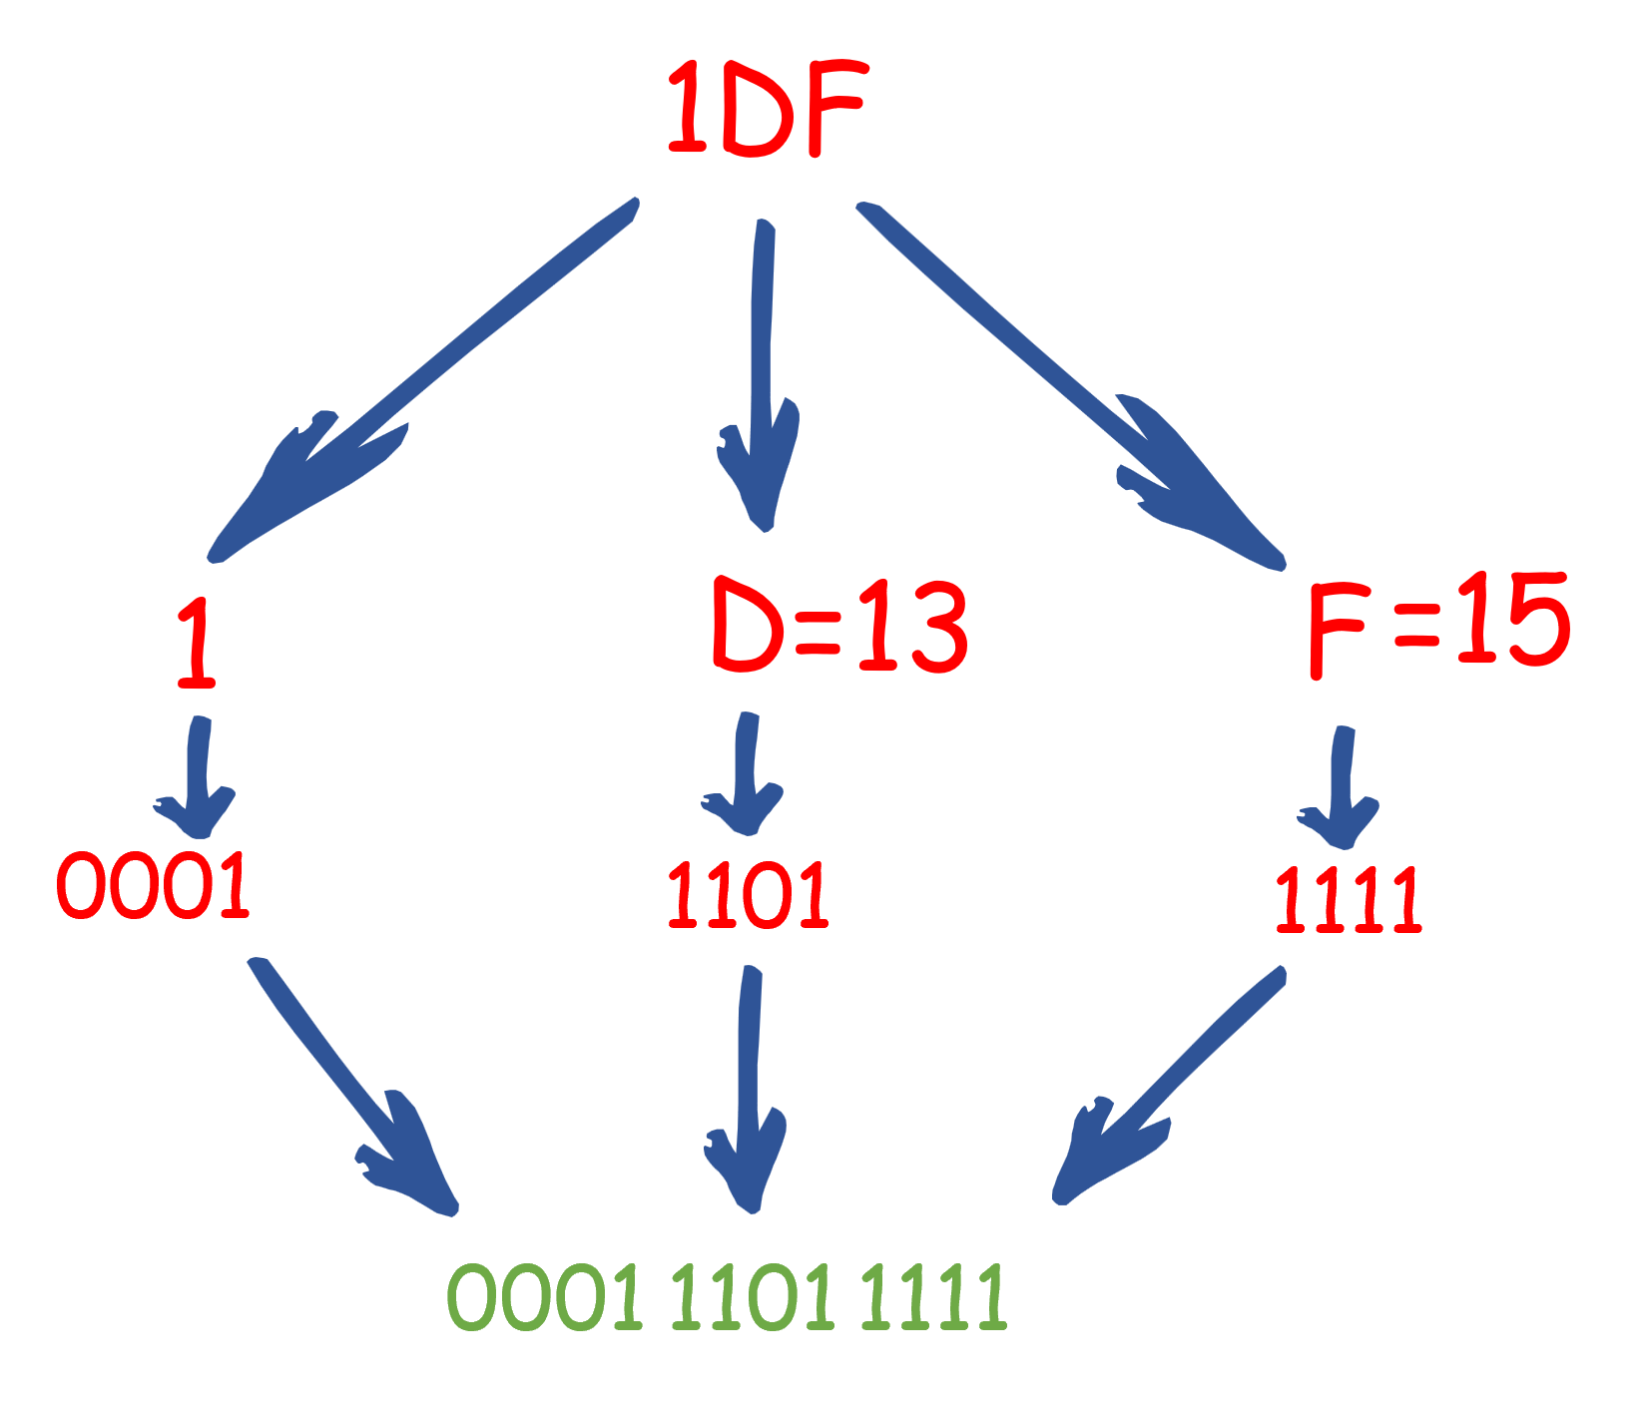
Direct Conversion:
Convert 1DF to Binary

Slide 11
Worked examples:
🟨 1D5₁₆ → 1 | D | 5 → 0001 1101 0101 → 0001 1101 0101.
🟨 5E9₁₆ → 5 | E | 9 → 0101 1110 1001 → 0101 1110 1001.
🟨 1DF₁₆ → 1 | D | F → 0001 1101 1111 → 0001 1101 1111.
Tip: Always group the final binary as nibbles (4 bits) for readability.

Slide 12
Programming Foundations
Level 1
Convert Binary to Hexa
in a simpler way
2

Slide 13
How to Convert Binary to Hexa?
Way 1 (Two-step):
Two steps:
1. Convert binary to decimal.
2. Convert decimal to hexa.
That’s it.

Slide 14
How to Convert Binary to Hexa?
Way 2 (Direct):
Group bits in fours from the right, then map each 4-bit group to one hex digit.

Slide 15
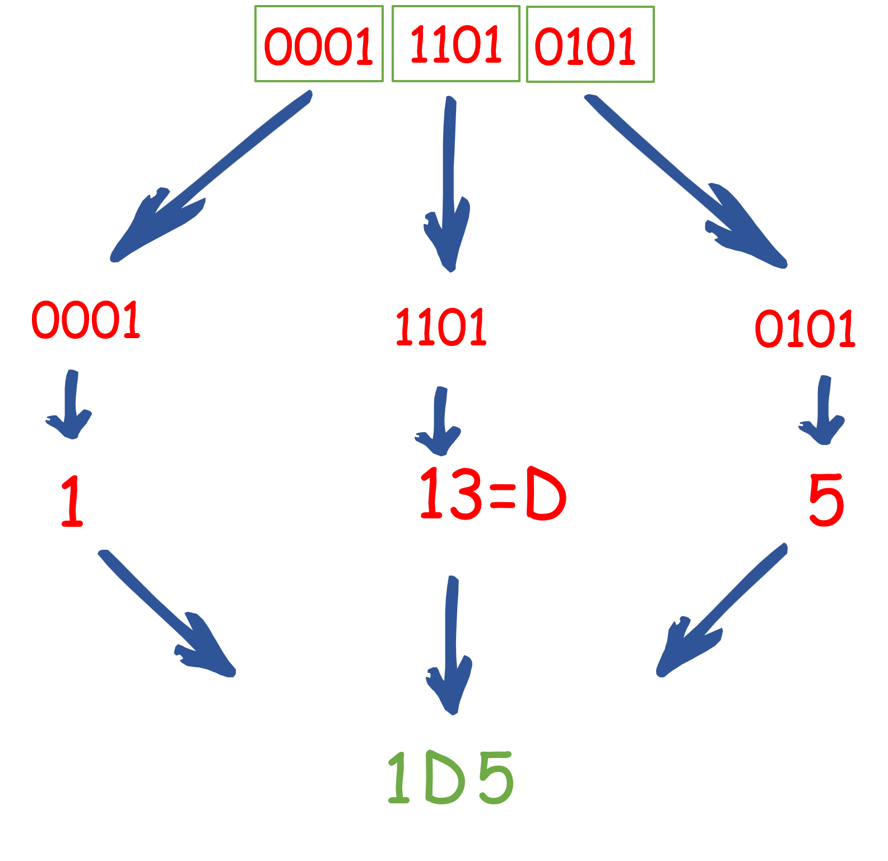
Direct Conversion:
Convert 000111010101 to Binary

Slide 16
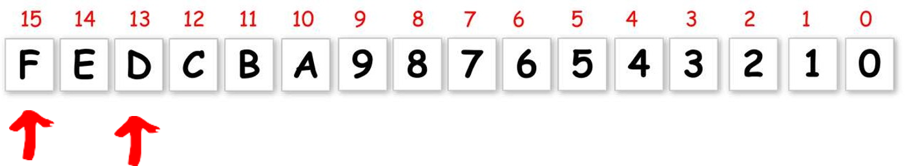
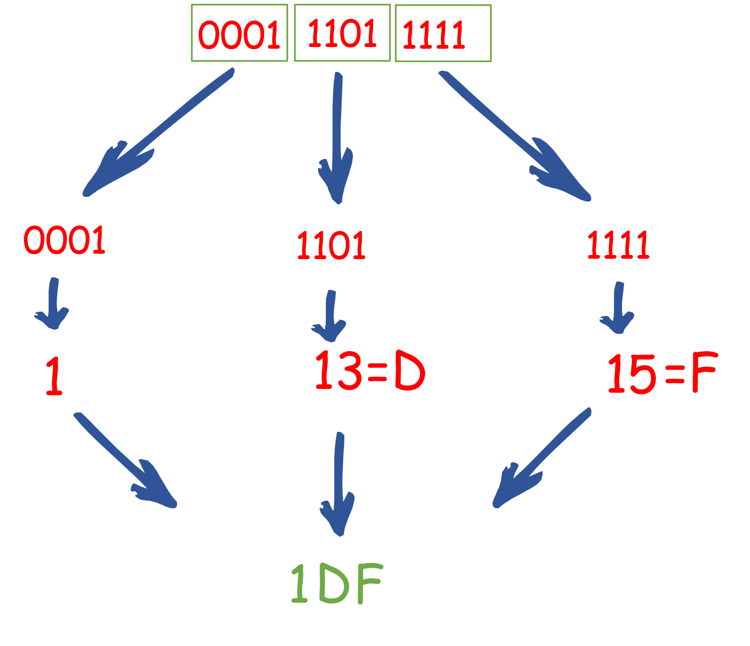
Direct Conversion:
Convert 000111011111 to Binary

Slide 17
Worked examples:
🟨 0001 1101 0101₂ → group 0001 | 1101 | 0101 → 1 D 5 → 1D5₁₆.
🟨 0001 1101 1111₂ → group 0001 | 1101 | 1111 → 1 D F → 1DF₁₆.

Slide 18
Why Direct Conversion Wins
🟨 Zero arithmetic once you know the nibble table.
🟨 One byte = two hex digits → memory dumps, instruction bytes, and color codes are clean and short.

Slide 19
🔗 Interconnection
🔹 Hex ↔ Binary maps 1 digit ↔ 4 bits (nibble), so 1 byte ↔ 2 hex digits.
🔹Use Way 2 (direct) for speed; use Way 1 to reinforce base-conversion theory.
🔹Grouping in nibbles keeps numbers readable and reduces errors when reading bytes, addresses, and encodings.

Slide 20
🧐 Activity
📋 Instructions:
Convert directly (use nibble mapping / 4-bit grouping only).
1️⃣ Hex → Binary
a) 12A4
b) 1C35
c) 100
d) 115C
2️⃣ Binary → Hex
a) 0001 0010 1010 0100
b) 0001 1100 0011 0101
c) 0001 0000 0000
d) 0001 0001 0101 1100

Slide 21
🧐 Activity Solution
📋 Solution:
1️⃣ Hex → Binary
a) 12A4 → 0001 0010 1010 0100
b) 1C35 → 0001 1100 0011 0101
c) 100 → 0001 0000 0000
d) 115C → 0001 0001 0101 1100
2️⃣ Binary → Hex
a) 0001 0010 1010 0100 → 12A4
b) 0001 1100 0011 0101 → 1C35
c) 0001 0000 0000 → 100
d) 0001 0001 0101 1100 → 115C

Slide 22
🏁 Conclusion
✅ Direct nibble mapping is the professional, fast path for Hex ↔ Binary.
✅ Keep everything grouped in 4-bit nibbles, pad with zeros on the left when needed.
✅ Use two-step (via decimal) to validate learning or when teaching base arithmetic foundations.
With these skills, your students can confidently read bytes, registers, addresses, and encodings in real-world tools and labs. 🚀

Slide 23
Thank you ☺

